Slide 1

Back-End of a Compiler: Machine-Dependent Code Optimization and Final Code Generation from Intermediate Code
CSA1410-Compiler Design
Presented by
Guided by
Keerthana.G (192521446)
Dr.Deepa.N

Slide 2
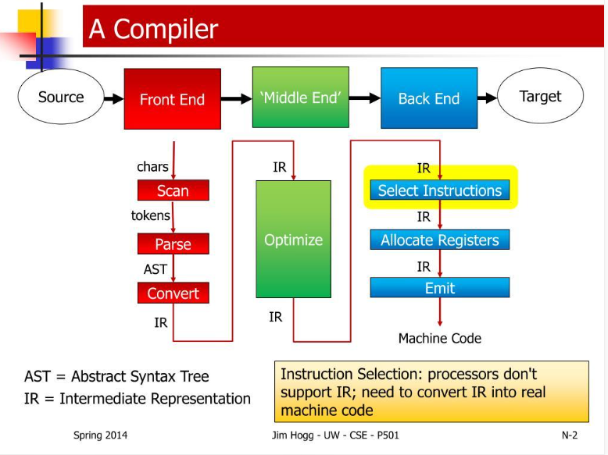
Introduction
+
The back-end is the final phase of a compiler responsible for code generation.
It processes the intermediate representation (IR) produced by the front-end.
It converts intermediate code into target machine code or assembly language.
It performs code optimization to improve execution speed and efficiency.
It reduces unnecessary instructions and improves resource utilization.
Its design depends on the target processor, instruction set, registers, and architecture.

Slide 3
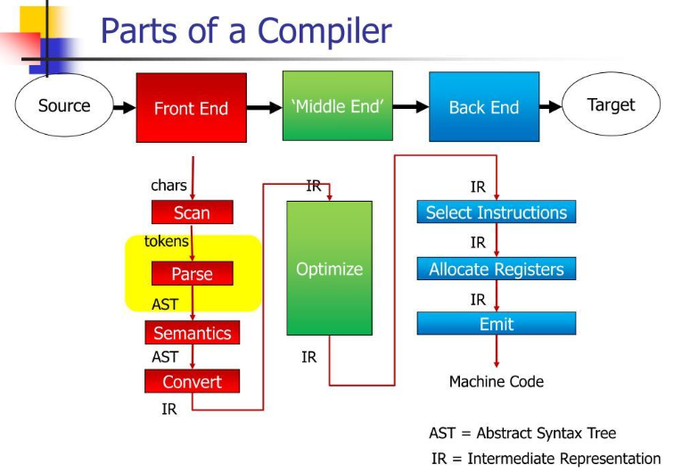
Compiler Architecture
Front-end: Lexical, syntax, and semantic analysis.
Middle-end: Intermediate representation and optimization.
Back-end: Target-specific optimization and code generation.
Each stage transforms the program for the next stage.
Flow: Source Code → Front-End → Intermediate Representation → Back-End → Target Code

Slide 4
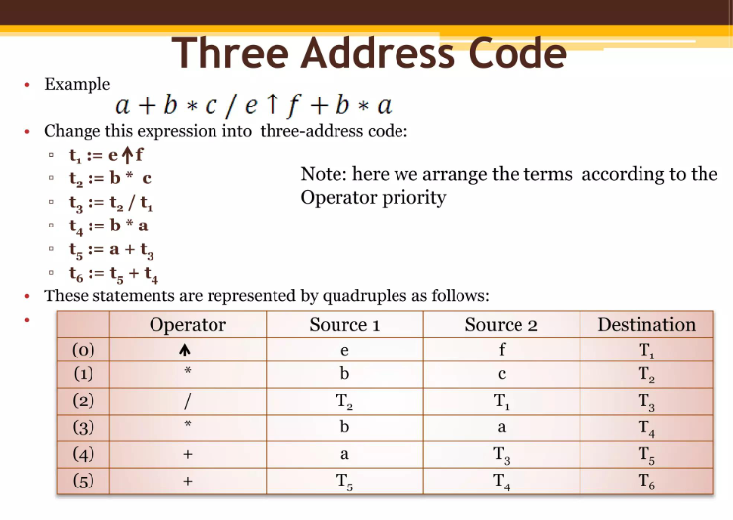
Intermediate Representation (IR)
IR is an internal form of a program.
It separates source-language details from target hardware.
It simplifies optimization and code generation.
Three-address code is one common IR format.
Example: t1 = a + b followed by c = t1 * 2.

Slide 5
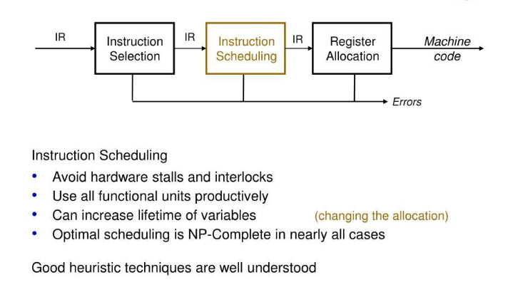
Register Allocation
CPU registers provide fast access to frequently used data.
The compiler determines which values should be stored in registers.
It considers how long each value is needed and whether values are used simultaneously.
If registers are insufficient, some values may be stored in memory, a process commonly called spilling.
Good register allocation reduces memory access and improves performance.

Slide 6
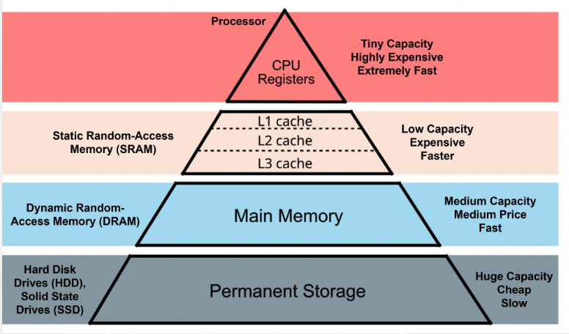
Memory Management
In compiler back-end design, memory management involves assigning and organizing storage locations for variables, temporary values, and other program data.
Determines where program values are stored when registers are not used.
Supports allocation of stack locations for local variables and function-call data.
Handles storage requirements for temporary values.
Considers the target architecture's memory layout and alignment requirements.
Works with register allocation to use available resources efficiently.

Slide 7
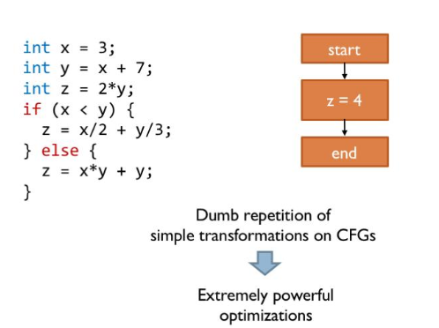
Back-End Optimization
Back-end optimization improves the efficiency of target-specific code while preserving the program's intended behavior.
Removes unnecessary target instructions where possible.
Simplifies instruction sequences.
Reduces redundant register transfers and memory operations.
May reduce code size or improve execution speed.
Considers the features and limitations of the target processor.

Slide 8
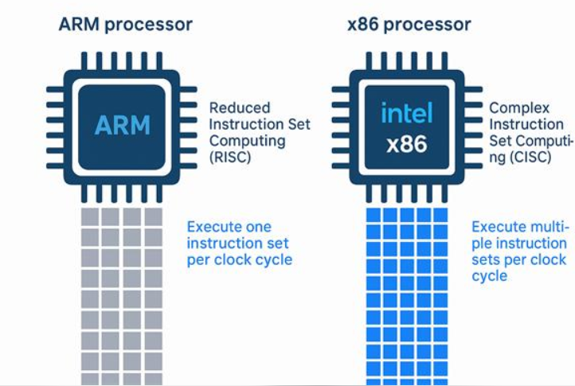
Machine Dependency
The back-end depends on the target processor's architecture.
Different processors support different instruction sets.
Register availability and addressing modes may differ.
The same intermediate code can target different processors.
Examples: x86-64 and ARM architectures.

Slide 9
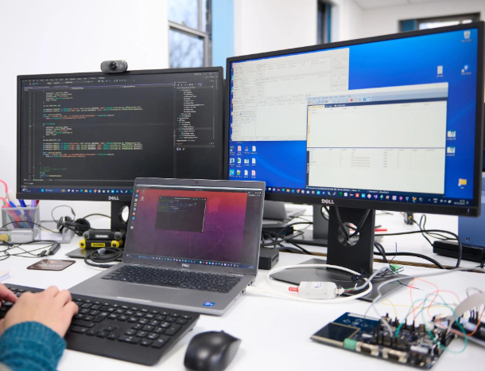
Applications and Challenges
Applications :
Operating systems and system software.
Embedded systems and microcontrollers.
Mobile and desktop applications.
Game engines and high-performance computing.
Challenges :
Balancing execution speed and code size.
Managing limited CPU registers.
Supporting different processor architectures.
Preserving program correctness during optimization.

Slide 10
Conclusion
The compiler back-end plays an important role in converting intermediate code into target code.
It performs instruction selection, register allocation, memory management, and instruction scheduling.
Back-end optimization reduces unnecessary instructions and improves code efficiency.
Target-code generation produces instructions suitable for the target processor.
The back-end considers processor architecture, available registers, and memory requirements.
Efficient back-end design improves execution speed and can reduce code size.
Overall, the compiler back-end helps generate efficient and reliable machine-level code.

Slide 11


Slide 12
THANKYOU

